Slide 1

Tele-Triage 101
Tele-triage Subgroup
Ver 1.3

Slide 2







Attribution-ShareAlike 2.5 India
(CC BY-SA 2.5 IN)
This is a human-readable summary of (and not a substitute for) the license available at https://creativecommons.org/licenses/by-sa/2.5/in/legalcode
You are free to:
Share — copy and redistribute the material in any medium or format
Adapt — remix, transform, and build upon the material for any purpose, even commercially.
The licensor cannot revoke these freedoms as long as you follow the license terms. Under the following terms:
Attribution — You must give appropriate credit, provide a link to the license, and indicate if changes were made. You may do so in any reasonable manner, but not in any way that suggests the licensor endorses you or your use.
ShareAlike — If you remix, transform, or build upon the material, you must distribute your contributions under the same license as the original.
No additional restrictions — You may not apply legal terms or technological measures that legally restrict others from doing anything the license permits.
Notices:
You do not have to comply with the license for elements of the material in the public domain or where your use is permitted by an applicable exception or limitation.
No warranties are given. The license may not give you all of the permissions necessary for your intended use. For example, other rights such as publicity, privacy, or moral rights may limit how you use the material.
Disclaimer:
This deed highlights only some of the key features and terms of the actual license. It is not a license and has no legal value. You should carefully review all of the terms and conditions of the actual license before using the licensed material.
Appropriate credit:
If supplied, you must provide a link to the creator and attribution parties, a copyright notice, a license notice, a disclaimer notice, and a link to the material.
Indicate if changes were made:
You must indicate if you modified the material and retain an indication of previous modifications.
You may need to get additional permissions before using the material as you intend.
Based after https://creativecommons.org/licenses/by-sa/2.5/in/

Slide 3
Disclaimer
We strive to maintain the best quality and timeliness of the deliverables, however, these documents do not form a product or service agreement, and there is no service level agreement provided. All collaterals and materials are provided as-is on a best effort basis only. While due diligence and a stringent review process have been followed in producing these documents and artifacts, there may be inadvertent errors of omission or commission that have slipped our process. These offerings are provided without any warranty or liability. The users agree to indemnify the administrators and maintainers of this document, the authors, the Telemedicine Society of India (https://tsi.org.in), the contributors and other associates or volunteers against any direct or indirect damages resulting from the information contained herein. The view expressed by individual contributors need not necessarily reflect the views or opinions of the Telemedicine Society of India, the reviewers and maintainers of these repositories, documents and artifacts.
Users are expected to ascertain the validity of the content against the latest guidelines published by the MoHFW and other departments of the Central Government of India and State Governments. https://www.mohfw.gov.in/pdf/Telemedicine.pdf
This material is licensed under "Creative Commons Attribution-ShareAlike 2.5 India". We do NOT guarantee any personal data protection or privacy rights adherence. Users and contributors, alike, are advised to diligently avoid submissions of any information they do not wish to make public. Disputes are subject to the jurisdiction of the courts in New Delhi, India only.

Slide 4
Contributors
Dr. Lavanian Dorairaj
Dr. Gunda Srinivas
Mr. Jai Ganesh Udayasankaran
Dr. Sai Praveen Haranath

Slide 5
What we shall learn
Why is it required
Who is this for
How to triage patients via remote means especially wrt the Covid-19
To detect, advise, test, monitor, treat and refer/evacuate patients remotely thereby decongesting hospitals while also isolating the disease
Helps avoid the risk of exposure for the GP which is essential when the health system resources are stretched
General Practitioners who can remotely support patients in remote areas
Doctors working in ERs and small hospitals requiring specialist support

Slide 6
What is Triage
“Triage can be defined as the process of deciding which patients should be treated first based on degree of sickness or severity of injury*”
The word is French and means ‘to separate out’ (Trier)
Triage is applied when too many serious patients (from accidents, battle, epidemics) come to a doctor simultaneously thereby making it difficult to see all at once.
In such a case the doctor quickly assesses each patient to decide who requires immediate treatment or admission and who can receive delayed care.
*Kaplan, J. A., In Cronin, B., & In Maus, T. (2019). Kaplan's essentials of cardiac anesthesia for noncardiac surgery

Slide 7
What is Tele-Triage
Tele-triage is the triage concept applied to the field of telemedicine to quickly assess the patient’s condition remotely, for appropriate decision making.
Today this extends to not just the phone but also the use of various connectivity options and video, multimedia, remote tests and software applications

Slide 8
Outcomes of Tele-triage
The outcome of Tele-triage is to classify patients into 3 main categories:
Whether he/she is in a life threatening situation and needs to visit a hospital immediately,
Whether he/she can wait safely to meet the doctor at the next available time physically,
Whether the patient can be advised on care plan that can be safely managed locally or at home.

Slide 9
Types of Telemedicine Triage (tele-triage)
Though there are many types of telemedicine interactions, but we are now focusing on the more important scenarios especially wrt Covid-19
The focus is on detecting, treating and monitoring cases at site and triaging them so that only the relevant /serious cases are routed to hospitals
This ensures social distancing that prevents spread of Covid-19
It also ensures limited patient travel and less crowding of hospitals

Slide 10
Tele-triage scenarios
Actions required of both parties shall be discussed
A Patient contacts the doctor by phone, chat, sms or videochat
A Caregiver (parent,spouse,relative, friend, professional) contacts the doctor by phone, chat, sms or videochat
A Remote medical assistant contacts the doctor by phone, chat, sms or videochat/ telemedicine application
A hospital doctor contacts a specialist by phone, chat, sms or videochat/ telemedicine application

Slide 11
Pre Tele-triage actions
Post Tele-triage actions
We are covering a large variety of scenarios and therefore need to first ensure readiness of the remote advisor to accept the Tele-triage request
In general this would include Equipment, Infrastructure, checklists, definitions and symptom complex criterias/response scoring
Mostly documentation that could be technical, legal and clinical decisions and appropriate communication to patients and follow-up when necessary.
We shall discuss these actions with each scenario

Slide 12
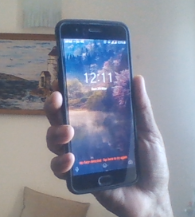
Scenario 1:
Tele-triage: Patient to Doctor: by Phone

Slide 13
Pre-Tele-Triage Actions
Doctors use various tools to record patient encounters - from sophisticated software to a basic notebook
The format for a telemedicine encounter is given in annexure A and B
Keep your format open and ready to record/note down within 10 seconds
The call triage algorithm should be readily accessible
During the Covid19 pandemic consider all patients infected till the triage determines otherwise
For phone calls from patients use a mic and earphone set for better quality
Lighting should be adequate (especially if using pen and paper)
If on night tele-call duty keep the phone & equipment near your chair or bed
A call should be picked-up before the 3rd ring, ideally the 1st ring

Slide 14
Tele-triage: Patient to Doctor: by Phone
On picking-up the call, note down the number, identify yourself and ask for the caller’s name (note down name and time)
Ask if the caller is a patient or a representative of the patient
Say ’ You are calling and requesting a certified medical professional for telephonic medical advice. I shall help as best as I can’ . Patient must say ‘Yes’(Informed consent)
Ask what his/her immediate problem is. If it appears not immediate or life threatening then ask for further demographic details as in the sample case-sheet (Anx ‘A’)
Next open your Covid-19 triage sheet (Anx ‘C’) to assess the patient. To ensure that you do not miss any point, use the checklist questions (coming up)
Continued…

Slide 15
Tele-triage...contd
Based on the assessment, ask further clinical questions to clarify co-morbidities and other complaints
After assessment, advice the patient and fill in the clinical details (Anx ‘B’), provisional diagnosis and Rx/advice
Once the doctor is satisfied that the patient has complaints that are NOT indicative of Covid-19, he can assess and triage for other clinical conditions as per standard protocols that he is already aware of

Slide 16
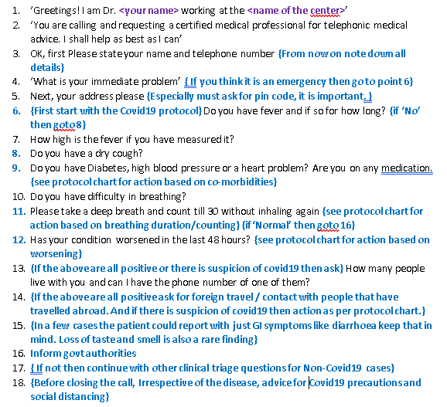
The Checklist
Questions

Slide 17
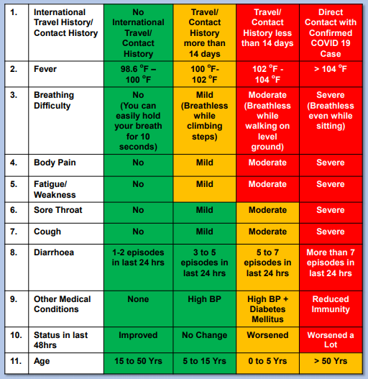
Covid-19 Triage Chart for GPs
Annexure: ’C’
1
2
3
4
Ask the following questions and tele-triage for:
Observe at home
Treat at home*
Transfer to Hospital
Emergency transfer
Patient to follow all Covid19 precautions including isolation
*In cases with prominent breathlessness along with other symptoms, transfer to hospital.
Ref: IAF Checklist
Notes:
Symptoms of Loss of taste and smell are cropping up in Covid19 cases
Doctors are adding loss of smell and taste — anosmia and dysgeusia — to the list of available screening tools for COVID-19 infection.

Slide 18
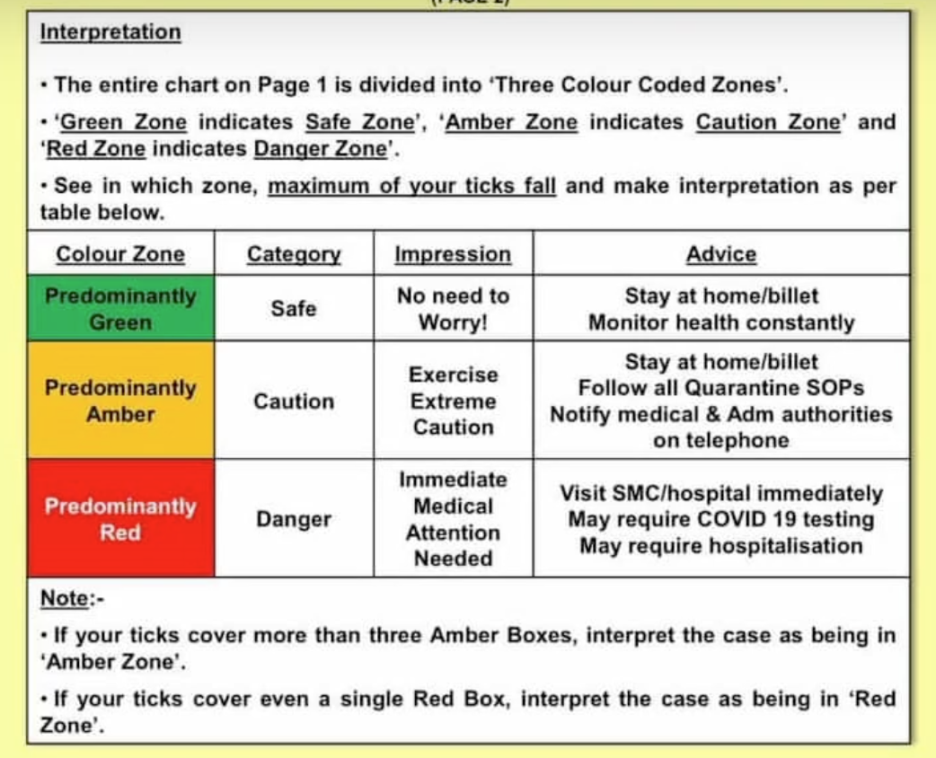
How to use the IAF Checklist for Triage
The checklist applies to individual patients and frontline providers who see these patients in an OPD
Place a tick mark in the box that
applies to you in the Checklist
Answer all questions from 1 to 11

Slide 19
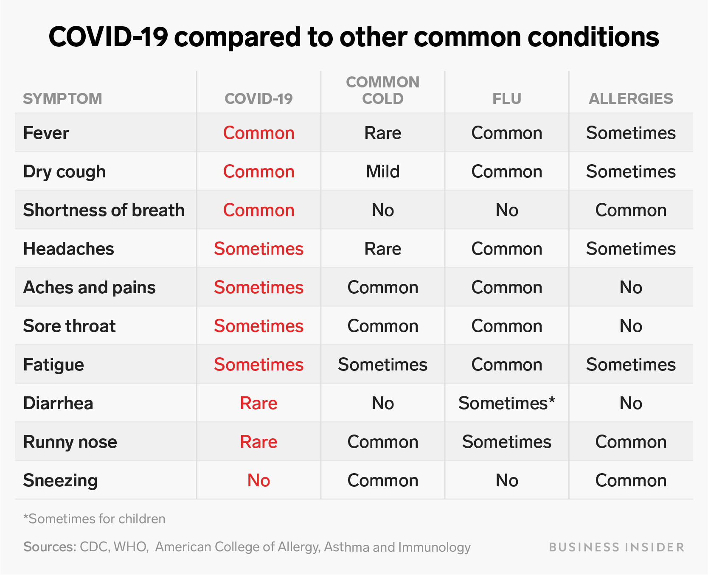
https://www.businessinsider.in/science/news/how-coronavirus-symptoms-compare-to-those-of-flu-allergies-and-the-common-cold/articleshow/74602420.cms

Slide 20
Post Tele-triage Actions
It is very important to check that you have documented properly, especially the patient consent, his identification, contact details and clinical & care details. Preserve this documentation.
Inform the authorities of any suspected cases and share details to ensure followup by the health worker
If the patient has been advised emergency evacuation or hospital admission then coordinate with your local hospital to see that :
The ambulance is despatched to the right person and address
The patient’s clinical details are shared with the ER doctor
Transfer the patient’s data to the doctor by software or on the call

Slide 21
Tele-triage: Patient to Doctor: by SMS/ missed call
On receiving the SMS. Note the time received
Call the person
Further is the same as a telephonic consult and triage

Slide 22
Tele-triage: Patient to Doctor: by Chat
On receiving the Chat. Note the time received
Call the person
Further is the same as a telephonic consult and triage
The person can also share documents and tests on chat to help you with the diagnosis

Slide 23
Tele-triage: Patient to Doctor: by Video-chat
The doctor has to be well dressed and presentable (including the surroundings) to accept a video chat
On receiving the Chat. Note the time received
You can view the patient’s face as also respiratory rate
The person can also share documents and tests on chat to help you with the diagnosis
Further is the same as a telephonic consult and triage

Slide 24
Scenario 2:
Tele-triage: Caregiver/guardian to Doctor
This Triage is similar to that of a patient call tele-triage
In addition it is important to take down details of the caregiver AND patient and record them both in the case sheet.
Details of the caregiver to be collected: full name, phone, relationship to the patient, address (if different from patient)
The rest is similar to patient tele-triage

Slide 25
Scenario 3:
Tele-triage: Medical Assistant (Health worker) to Doctor
Here the patient is first seen by a local medical assistant.
It is important to take down details of the medical assistant AND patient and record them both in the case sheet.
Details of the med asst to be collected: full name, phone, address, Employee ID (if available)
These interactions are richer since vitals can be collected along with various test results. The local med asst can carry out doctor guided activities like ultrasound, ECG, echocardiography, etc (applies only when interacting with a specialist on referral). In many cases sophisticated software tools are used.(local govt/state rules apply) . The rest is similar to patient tele-triage

Slide 26
Protocols for Med Asst (Health worker) manned centers
All patients reporting should be received and examined as per covid19 protocols
Patents to be seated/standing 6 feet apart. Outside seating is better.
Patient should be made to wash their hands with liquid soap/sanitizer on arrival
Give a surgical mask to wear (where possible) or cover mouth and nose with a cloth/hankie/pallu
No interaction to happen between patients
Med Asst to wear a mask, gloves, eye protectors and gown
His physical contact with the patient to be kept to a minimum and he will see only one patient at a time (no crowding around by patients)
Telemedicine indemnity form can be temporarily foregone to avoid infection via fomites. Willingness of the patient for telemed consult will be implicit. (BUT, Click a photo of the patient with thumbs up as proof)
All equipment to be sterilized as per standard protocols, after each use
Disposables to be disposed off as per biohazard protocols in vogue (see reference section)

Slide 27
Scenario 4:
Tele-triage: Doctor to Specialist
Used to contact a specialist for a patient in ER/ ward/ICU
Keep patient age, gender, comorbidities, days in hospital, vitals, lab tests and specific question wrt the patient READY before call/Video call.
The call has to be short, crisp and clear about the answer required. Do’nt waste time
Call the specialist, identify yourself and state the question. “Please advise on patient…. Whose findings are…...” “ I need to know the line of treatment…..”
Software use makes this easy
When free, download and go through the GoI Covid-19 guidelines as below:
https://www.mohfw.gov.in/pdf/GuidelinesonClinicalManagementofCOVID1912020.pdf

Slide 28
Flow Charts
Please visit pages 36 to 42 for all the mandated work flows during tele-triage, in the document:
’Telemedicine practice Guidelines’, by the BOARD OF GOVERNORS In supersession of the Medical Council of India. Please use the link below to download the said document
https://www.mohfw.gov.in/pdf/Telemedicine.pdf
It is mandatory for you to completely read this document and fully understand it before taking-up telemedicine services

Slide 29
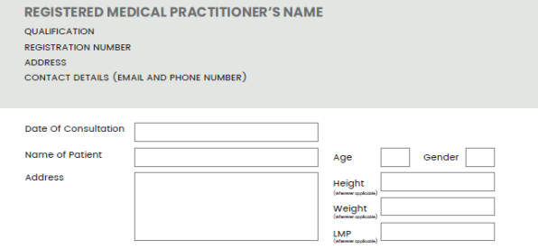
Case Sheet: Demographics
Annexure ;’A’
Can add details of caregiver here
Phone:
UID:
As mandated by the ’Telemedicine practice Guidelines’ Annexure 2
https://www.mohfw.gov.in/pdf/Telemedicine.pdf

Slide 30
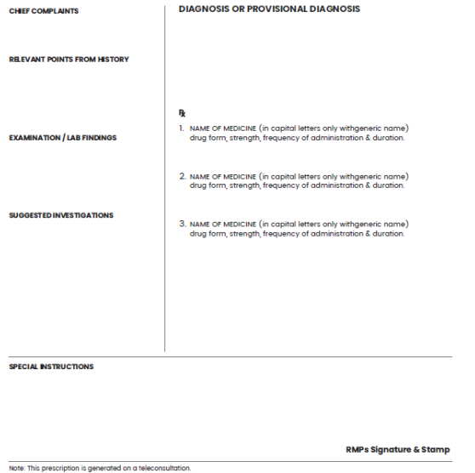
Case Sheet: Clinicals
Annexure: ‘’B’
Video Call may allow evaluation of pallor, throat, respiratory rate and work of breathing , cyanosis and general condition
As mandated by the ’Telemedicine practice Guidelines’ Annexure 2
https://www.mohfw.gov.in/pdf/Telemedicine.pdf

Slide 31
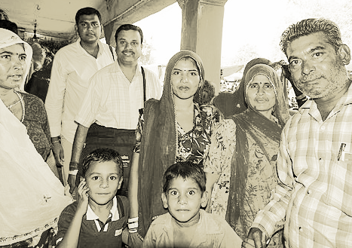
Tele-Triage of Non-Covid-19 cases
Coming in future
Image Source: https://commons.wikimedia.org/wiki/File:Jaipur-Tripolia_Bazar-Indian_family_shopping-20131017.jpg

Slide 32
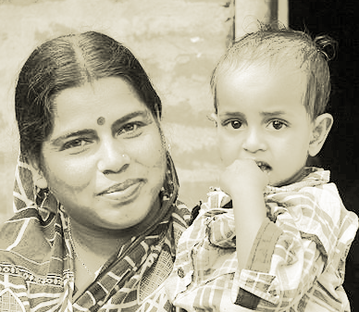
Tele-Triage of Maternity and child health cases
Coming in future
Image source: https://commons.wikimedia.org/wiki/File:Mother_and_Child_at_Village_of_West_Bengal,India.jpg

Slide 33
References and suggested reading..Page 1
Annexure : ’D’
In Kaplan, J. A., In Cronin, B., & In Maus, T. (2019). Kaplan's essentials of cardiac anesthesia for noncardiac surgery. https://www.elsevier.com/books/essentials-of-cardiac-anesthesia-for-noncardiac-surgery/kaplan/978-0-323-56716-9
Huibers, L., Smits, M., Renaud, V., Giesen, P., & Wensing, M. (2011). Safety of telephone triage in out-of-hours care: a systematic review. Scandinavian journal of primary health care, 29(4), 198–209. https://doi.org/10.3109/02813432.2011.629150 https://www.ncbi.nlm.nih.gov/pmc/articles/PMC3308461/
Smits, M., Hanssen, S., Huibers, L., & Giesen, P. (2016). Telephone triage in general practices: A written case scenario study in the Netherlands. Scandinavian journal of primary health care, 34(1), 28–36. https://doi.org/10.3109/02813432.2016.1144431 https://www.ncbi.nlm.nih.gov/pmc/articles/PMC4911030/
Covid Remote Consultations, a visual guide https://www.bmj.com/content/bmj/368/bmj.m1182/F1.large.jpg
COVID-19 PREPAREDNESS CHECKLIST FOR RURAL PRIMARY HEALTH CARE & COMMUNITY https://cdn.georgeinstitute.org/sites/default/files/documents/covid-19-preparedness-guidance_checklist-for-rural-primary-health-care_community-health-settings-in-india-10.pdf

Slide 34
References and suggested reading..page 2
Annexure : ’D’
Guidelines on Clinical Management of COVID – 19, MoHFW, GoI https://www.mohfw.gov.in/pdf/GuidelinesonClinicalManagementofCOVID1912020.pdf
Doctor’s Handout https://docs.google.com/presentation/d/1UsPFdbzyC6oAL7YBsgrhrMJndhZNVsl0XeyuYpIO9q0/edit#slide=id.g828b212ded_0_124
Remote consulting: a survival guide
https://www.gp-update.co.uk/SM4/Mutable/Uploads/pdf_file/Remote-consulting-survival-guide---copyedited-FINAL_3.pdf
I Biomedical Waste (Management and Handling) Rules. The Bio-Medical Waste (Management and Handling) Rules; 1998 are conferred by section 6,8, 25 of the Environment (Protection) Act, 1986 (29 of 1986).
https://www.gpcb.gov.in/pdf/bmw_ws.pdf
Sample TeleTriage Video- https://youtu.be/soujM_Bf-9A

Slide 35
Covid Checklists, others
Annexure : ’E’
Covid19 checklist and questions for phone/Video call : http://www.ambupod.com/covidchecklist.pdf
This presentation: http://www.ambupod.com/teletriage.pdf
COVID 19 Checklist -Medical Services, Indian Air Force
https://www.youtube.com/watch?v=N7BKYKmqNXw

Slide 36
Thank you, Questions?
Dr. Lavanian Dorairaj
MBBS (1980), Prim Av Med, Cert Hosp Admin, Certified Expert DICOM and HL7 (USA)
Director and CEO
LYNK AmbuPod Pvt Ltd
www.ambupod.com (24/7 affordable rural healthcare)
HCit Consultant
www.hcitconsultant.com (Consultancy in Healthcare IT)

